Slide 1



G5 Presentation
Participants: Alex Castillo, Ignacio Cabrera, Victor Gerardo & Larry W. Davila
IRON KAGGLE

Slide 2
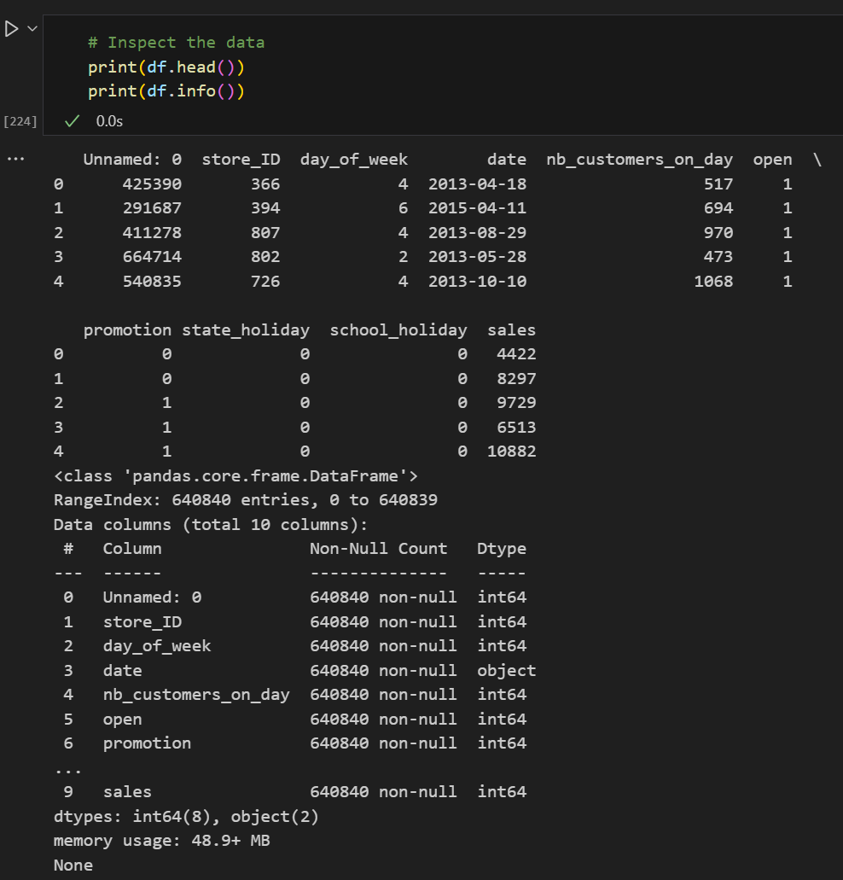
Data Evaluation and Pre-Processing
sales.csv data verification to understand it
Date identified as data type object then, month was extracted
To simplify the model data evaluation and change from categorical to numerical, the state_holiday with values 0, a, b and c was modified to 0 and 1.
Used features: ['store_ID', 'day_of_week’, 'nb_customers_on_day', 'open', 'promotion’, 'state_holiday', 'school_holiday','month']
Welcome

Slide 3
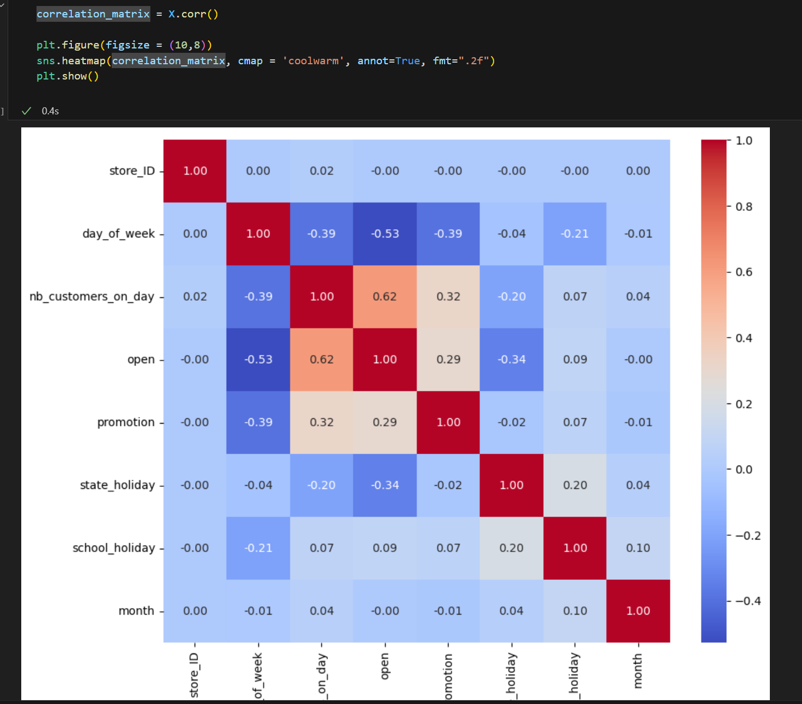
Correlation Matrix
Evaluation was performed for columns correlation
Welcome

Slide 4
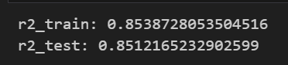
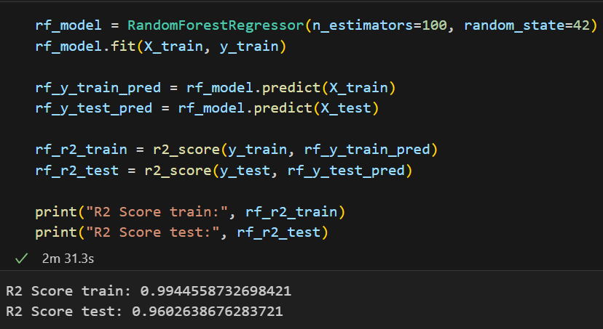
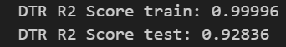
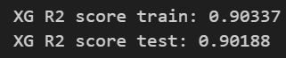
Models Tested and results obtained
Linear Regression
Decision Tree Regressor
xgBoost Regressor
Selected Model
RandomForest Regressor
Welcome

Slide 5
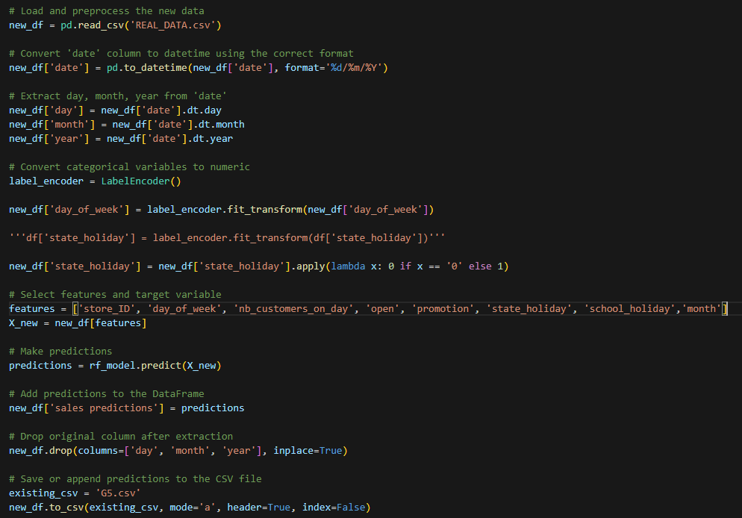
Real Data Treatment and Predictions Process
Challenges:
Source date format
Removal of new columns used for prediction process.
New G5.csv file creation.
Welcome

Slide 6
Thanks!!!
Happy Coding!

